Slide 1
SENTIMENT ANALYSIS
RNN vs LSTM vs GRU
A deep-dive comparison on the IMDb Movie Reviews Dataset

Slide 2
OVERVIEW
Objective
01
02
03
Classify sentiment
Compare 3 architectures
Find the best fit
Label 50,000 IMDb reviews as positive or negative
Simple RNN, LSTM, and GRU — same data, same setup
Which model wins on accuracy, speed, and long text
2 / 10

Slide 3
DATASET
IMDb movie reviews
50,000
25,000
25,000
Total reviews
Positive
Negative
Balanced classes → accuracy is a reliable metric here.
3 / 10

Slide 4
METHODOLOGY
Preprocessing pipeline
Raw text
→
Cleaning
→
Tokenize
→
Vocabulary
→
Sequences
→
Padding
Lowercase + strip HTML/punctuation
Split into words
Top 10,000 words → index
Words → integer IDs
Fixed length = 200
4 / 10

Slide 5
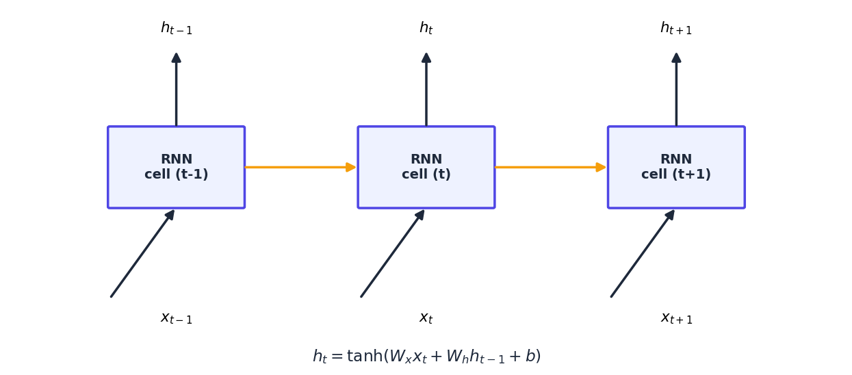
MODEL 1 OF 3
Simple RNN
Reads a review one word at a time, updating a single hidden state that carries memory forward. Simple, fast, but forgets earlier context in long reviews (vanishing gradients).
Gates: None
Memory: Short-term only
Best for: Short sequences, fast baseline
5 / 10

Slide 6
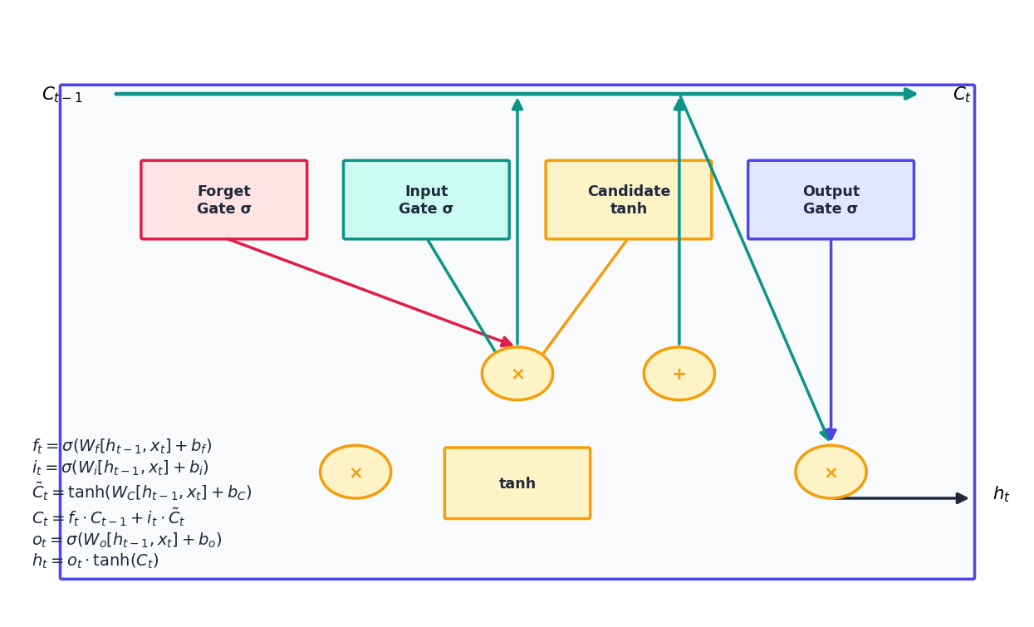
MODEL 2 OF 3
LSTM
Adds a dedicated cell state plus three gates — forget, input, output — that decide what to discard, add, and expose. This gives it strong control over long-range context.
Gates: 3 (forget, input, output)
Memory: Long-term (cell state)
Best for: Long, complex reviews
6 / 10

Slide 7
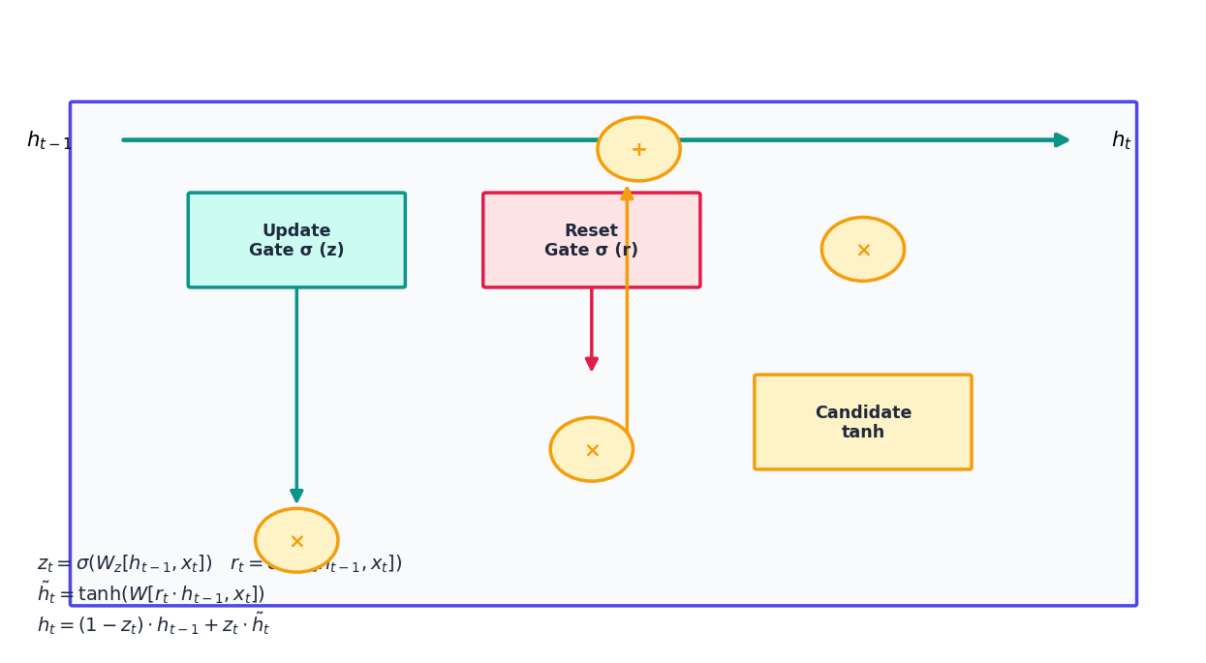
MODEL 3 OF 3
GRU
A leaner alternative to LSTM — merges memory into one state and uses just two gates: update and reset. Roughly 25% fewer parameters, so it trains faster with similar accuracy.
Gates: 2 (update, reset)
Memory: Long-term (simplified)
Best for: Long text, limited time/compute
7 / 10

Slide 8
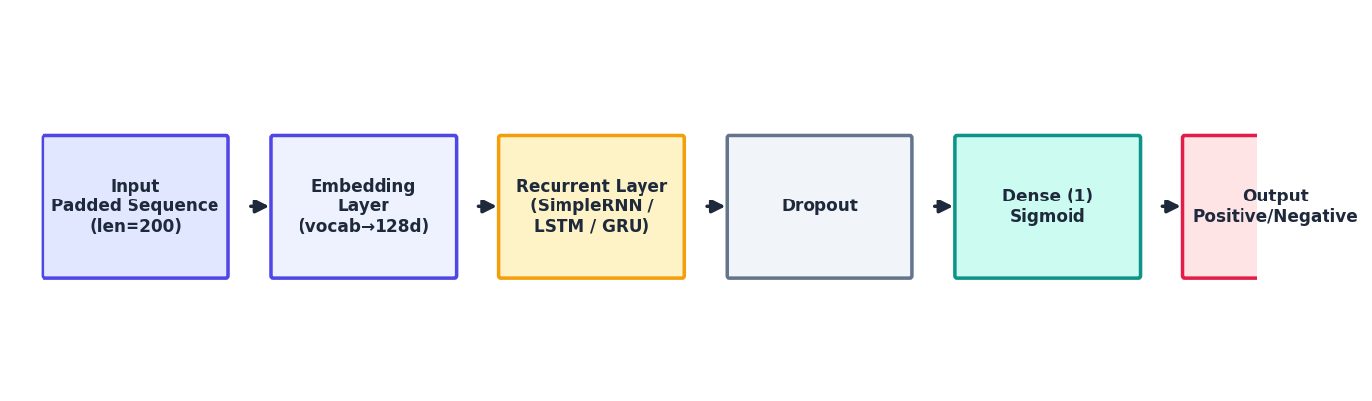
MODEL
Shared architecture & training setup
Vocabulary
Seq. length
Embedding
Hidden units
Dropout
Batch size
10,000
200
128
64
0.4
128
8 / 10

Slide 9
RESULTS
Comparison & analysis
Model | Accuracy | Precision | Recall | F1 | Time (s)
Simple RNN | TBD | TBD | TBD | TBD | TBD
LSTM | TBD | TBD | TBD | TBD | TBD
GRU | TBD | TBD | TBD | TBD | TBD
Best model
LSTM / GRU — gates beat vanishing gradients
Fastest
Simple RNN, then GRU, then LSTM
Fill in from comparison_df after running
Best for long text
LSTM — dedicated cell state
9 / 10

Slide 10
Conclusion
Gated models (LSTM, GRU) are the right default for long, nuanced text like movie reviews.
Notebook — theory + full implementation
Saved model (.keras / .pth)
Performance comparison table
This presentation
Professional README
10 / 10

